Slide 1
INVESTMENT CASE STUDY SUBMISSION
Group Name: Technocrats
Aditya Chopra
Sahil Bansal
K Bhagyashree

Slide 2
About The Investment Case Study
Spark Funds an asset management company wants to make investments in a few companies based on global trends.
What is the strategy? Spark Funds wants to invest where most other investors are investing. This pattern is often observed among early stage startup investors.
Business objective: The objective was to identify the best sectors, countries and suitable investment type for making investments. The overall strategy is to invest where others are investing, implying that the 'best' sectors and countries are the ones where most investors are investing.
Goals of data analysis:
Investment type analysis: For this particular analysis we compared the typical investment amounts in the venture, seed, angel, private equity etc. and choose the type that is best suited.
Country analysis: We identified the countries which have been the most heavily invested in the past.
Sector analysis: Mapped the distribution of investments across the eight main sectors as it was the required condition.
Hence we achieved the results as expected.

Slide 3
Analysis-Part1
The part 1 of our analysis including in depth study of our data sets as different data sets were in the form of text file or .csv format and hence also required some special encoding for decrypting them in Jupiter notebook for analysis.
After decrypting them successfully various tasks were performed for finding out number of things which are stated as follows:-
Finding the number of unique companies present in rounds2 and company file.
Finding which column can be used as the unique key for each company in the companies data frame.
Are there any companies in the rounds2 file which are not present in companies ?
Merging both company and rounds2 dataframe and finding the number of rows in this dataframe.
Average funding amount invested in venture type, angel type, seed type & private equity type
Considering that Spark Funds wants to invest between 5 to 15 million USD per investment round, which investment type is the most suitable for them?
Top, second and third English speaking country in terms of:
Total number of Investments (count)
Total amount of investment (USD)
Top , second & third sector name’s respectively(no. of investment-wise)
Number of investments in top , second & third sector .
Which company received the highest investment in top & second sector respectively?

Slide 4
Problem solving methodology
Our problem solving methodology included step by step prosecution of data , as follows:-
Understanding all the necessary conditions mentioned for the analysis
Analysing the data sheets provided
Performing various tasks required on data set in Jupyter notebook.
Evaluating the required results using data analysis in python and filling the investment datasheet provided.
Finally, representing our results using Tableau - visualization tool.

Slide 5
Analysis-Part1 (depth analysis)
During the python analysis , we had to keep some points in mind , which are as follows:-
While retrieving data from various files , we had to keep a check on the formats of the file and hence also apply encoding , wherever required to get the data in the correct format.
Check for NaN , i.e null values in all dataframes and removing them wherever they do not effect our over all analysis.
Some key steps taken by us in our analysis are:-
During merging of rounds2 table and company table we first converted all the ‘permalink‘ values from company table to lower case as they were present in rounds2 table and hence we were able to join both the frame’s to get a master_frame.
During analysis of top9 countries based on raised_amount_usd we got top 3 countries which included CHN as 2nd country , which is not an English specking country and hence was dropped out and top 3 English speaking countries came out to be :- USA, GBR & IND respectively.
To get the column ‘primary_sector’ from ‘category_list ‘ column in master_frame we used pipeline split logic.
After importing mapping.csv file we had to apply a special data purifying task on the catergory_list column as there was spelling error present in the whole column and thus ‘0’ after the first position of the word was replaced by ‘na’ and ‘0’ at first position of the word was replaced by ‘Na’. For this we developed a regex expression which was used in the process of data purifying task.
Keeping in mind the important conditions mentioned like 5-15 million usd dollar , English speaking countries etc .
Preparing all the data for visual analysis.

Slide 6
Analysis-Part2
This part of analysis includes the visual analysis on the tableau interface.
For analysis in tableau , few dataframes were taken from our python analysis , which are:-
Master_frame
Top9 frame
D1,D2 & D3 frames respectively.
Now various points were analysed in tableau , which are :-
A plot showing the fraction of total investments (globally) in venture, seed, and private equity, and the average amount of investment in each funding type. This chart should make it clear that a certain funding type (FT) is best suited for Spark Funds.
A plot showing the top 9 countries against the total amount of investments of funding type FT. This should make the top 3 countries (Country 1, Country 2, and Country 3) very clear.
A plot showing the number of investments in the top 3 sectors of the top 3 countries on one chart (for the chosen investment type FT).
Hence our analysis in tableau almost gave us the same results as in python and thus our analysis ended.

Slide 7
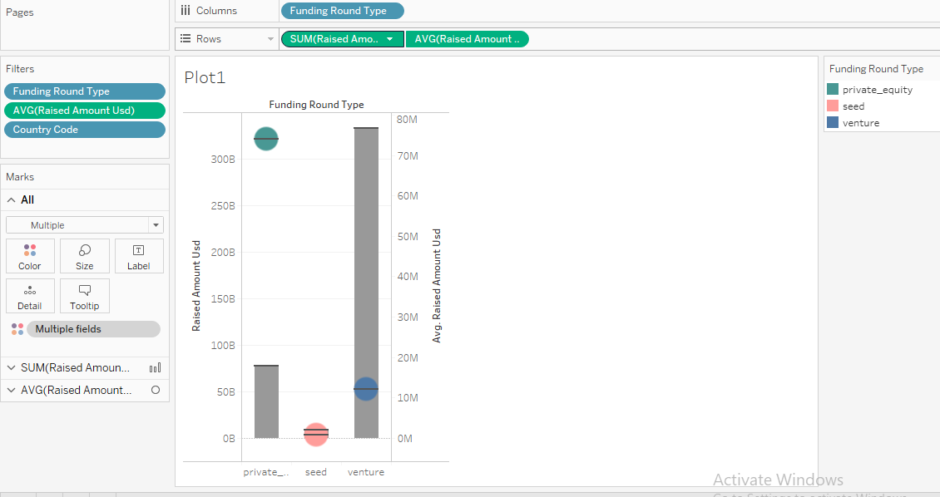
Results
Plot 1:
The plot shows the fraction of total investments (globally) in venture, seed, private equity and the average amount of investment in each funding type.

Slide 8
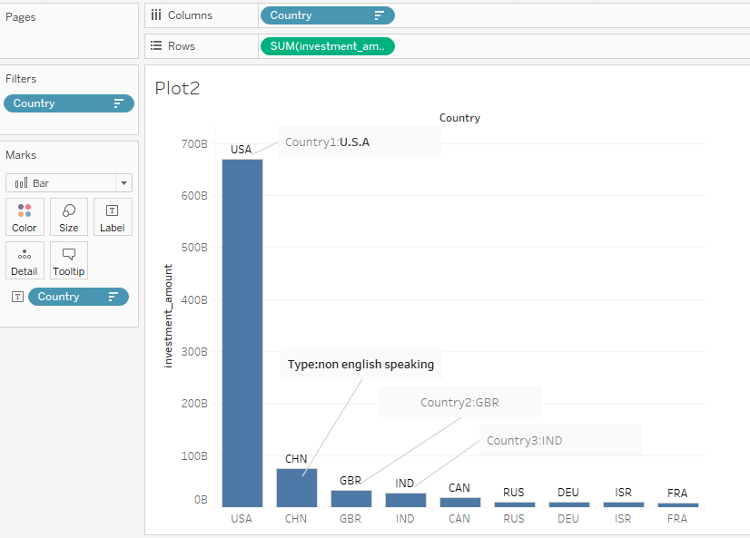
Results
Plot 2:
The plot shows Top 9 countries against total amount of investments of funding type FT.
The top three countries are USA, GBR, IND.

Slide 9
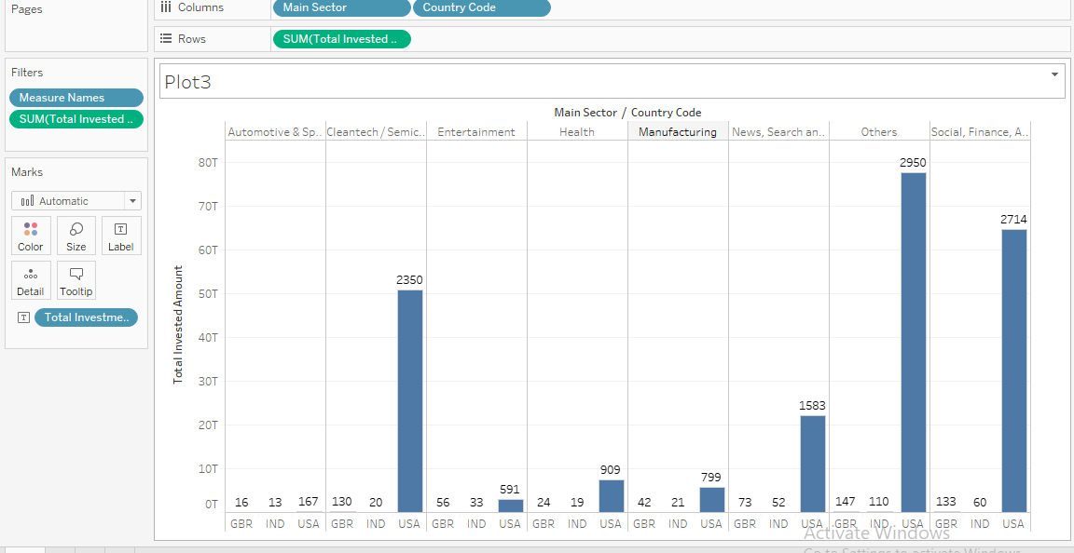
Results
Plot 3:
The sum of total invested amount vs main sector and country code is plotted
get top 3 main sectors in top 3 countries.

Slide 10
Conclusions
The visualization is done with the Tableau tool by using data frames that we obtained after analyzing the data in Jupyter notebook. The results shown in plots make clear that funding type Venture is best suited for Spark funds.
It shows the top 3 countries in which investment was maximum in Venture type. Thus, provides a list of top 3 countries to assist the Spark funds for the countries in which they should invest.
Also analysis provides us with the top 3 sectors to invest in each of the top 3 countries.
The analysis also provides us with the Companies to invest in respective sector in respective country.
Thus, with the help of analysis we achieved detailed results to help the Spark funds to invest in and get higher returns based upon their supposition.

